Slide 1

DEEP LEARNING ASSIGNMENT 3
SUBMITTED TO : Mr. C V S N REDDY
SUBMITTED BY : TEJAAL M
USN : ENG19CS0334
SEMESTER : 5
YEAR : III
SECTION : F
DAYANANDA SAGAR UNIVERSITY
DEPARTMENT OF COMPUTER SCIENCE & ENGINEERING
SCHOOL OF ENGINEERING
Dayananda Sagar University
Kudlu Gate
Bangalore – 560068

Slide 2
DEEP NEURAL NETWORKS

Slide 3
DEEP NEURAL NETWORKS
Each synapse has an associated weight, which impacts the preceding neuron’s importance in the overall neural network.
Weights are a very important topic in the field of deep learning because adjusting a model’s weights is the primary way through which deep learning models are trained.
Once a neuron receives its inputs from the neurons in the preceding layer of the model, it adds up each signal multiplied by its corresponding weight and passes them on to an activation function, like this:

Slide 4
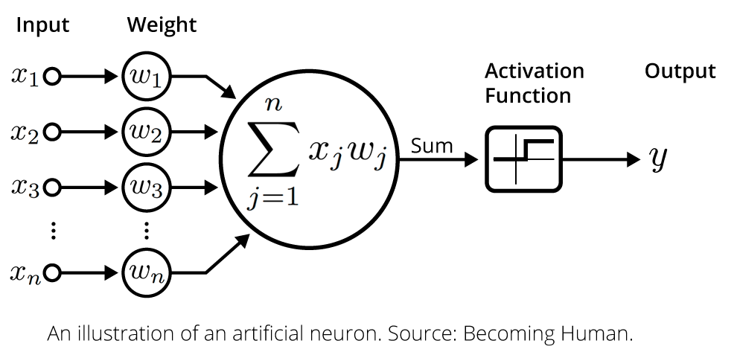
DEEP NEURAL NETWORKS
The activation function calculates the output value for the neuron. This output value is then passed on to the next layer of the neural network through another synapse.
This serves as a broad overview of deep learning neurons.

Slide 5
DEEP NEURAL NETWORKS
Activation functions are a core concept to understand in deep learning.
They are what allows neurons in a neural network to communicate with each other through their synapses.
We learned that neurons receive input signals from the preceding layer of a neural network. A weighted sum of these signals is fed into the neuron's activation function, then the activation function's output is passed onto the next layer of the network.
There are four main types of activation functions
Threshold functions
Sigmoid functions
Rectifier functions, or ReLUs
Hyperbolic Tangent functions

Slide 6
DEEP NEURAL NETWORKS
FOR EXAMPLE:
The Parameters In Our Data Set
Square footage
Bedrooms
Distance to city center
House age
These four parameters will form the input layer of the neural network.
The output layer is the component of the neural net that actually makes predictions.

Slide 7
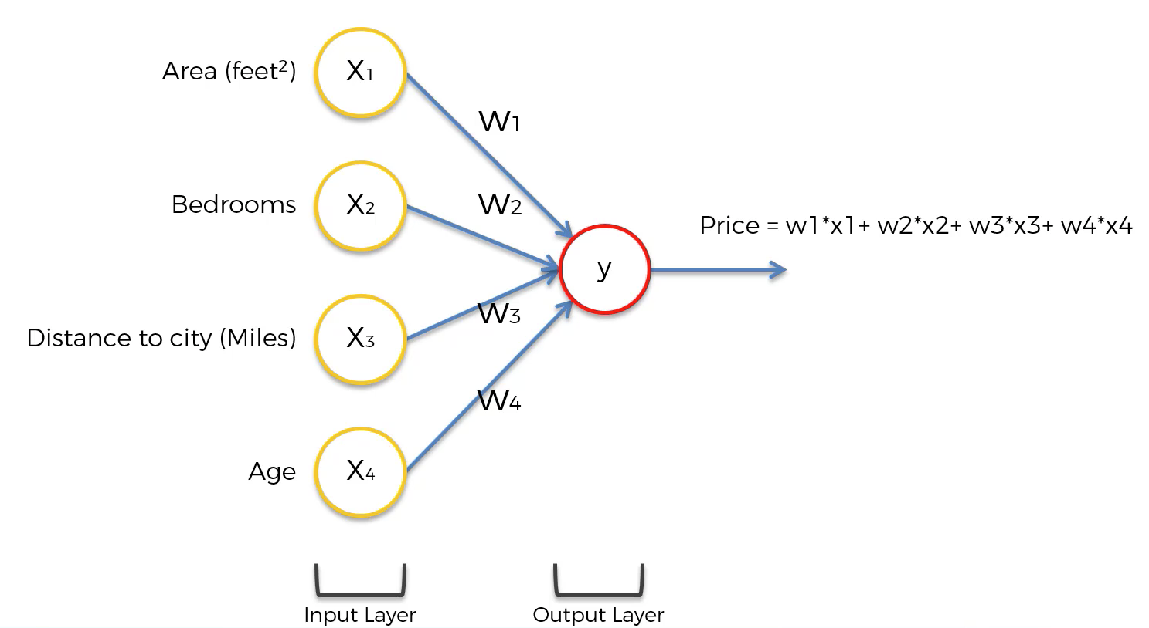
DEEP NEURAL NETWORKS

Slide 8
DEEP NEURAL NETWORKS
While this diagram is a bit abstract, the point is that most neural networks can be visualized in this manner:
An input layer
Possibly some hidden layers
An output layer
It is the hidden layer of neurons that causes neural networks to be so powerful for calculating predictions
For each neuron in a hidden layer, it performs calculations using some (or all) of the neurons in the last layer of the neural network. These values are then used in the next layer of the neural network.
Neurons in the middle layers of a neural net are activated (meaning their activation function returns 1) for an input value that satisfies certain sub-properties.
The process through which neurons determine which input values to use from the preceding layer of the neural net is called training the model.

Slide 9
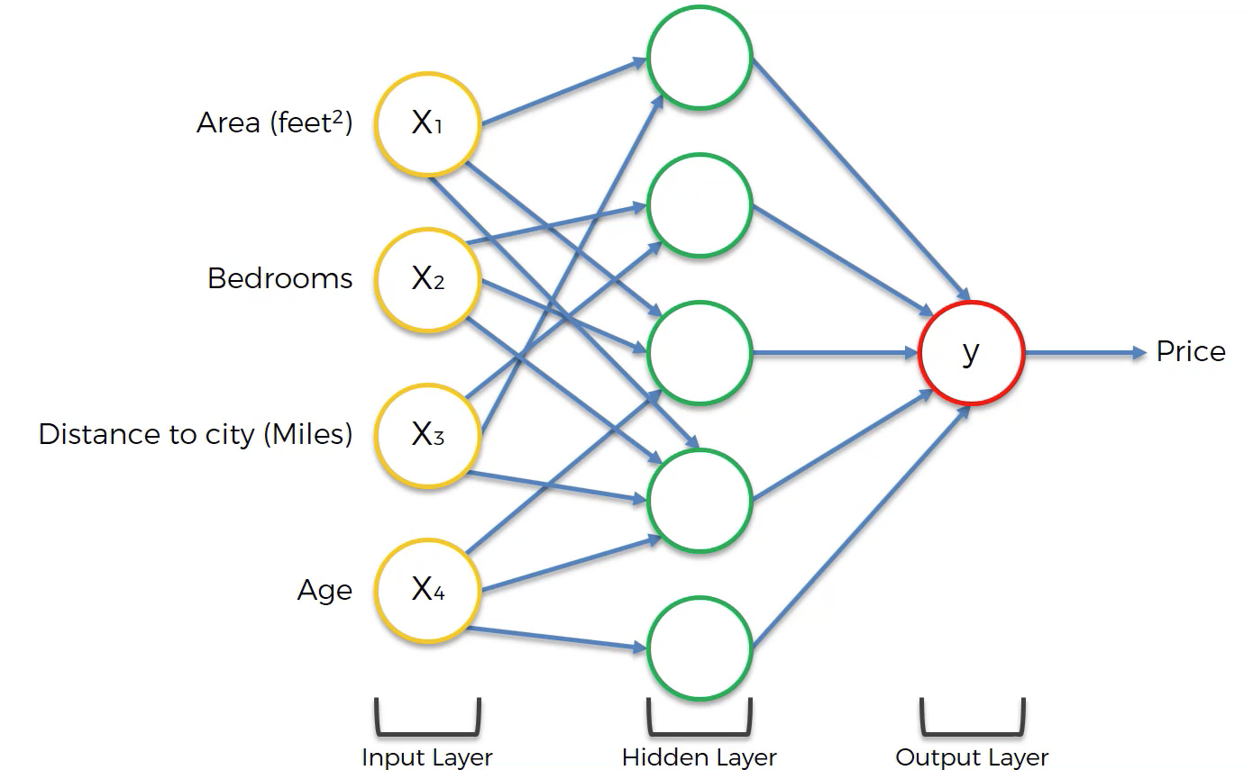
DEEP NEURAL NETWORKS
Visualizing A Neural Net’s Prediction Process

Slide 10
DEEP NEURAL NETWORKS
When visualizing a neutral network, we generally draw lines from the previous layer to the current layer whenever the preceding neuron has a weight above 0 in the weighted sum formula for the current neuron.
As you can see, not every neuron-neuron pair has synapse.
x4 only feeds three out of the five neurons in the hidden layer, as an example.
This illustrates an important point when building neural networks – that not every neuron in a preceding layer must be used in the next layer of a neural network.

Slide 11
DEEP NEURAL NETWORKS
We can summarize the construction of deep learning models in Keras using the Sequential model as follows:
Define your model: create a Sequential model or Function API model and add layers.
Compile your model: specify loss function and optimizers and call the .compile() function.
Fit your model: train the model on data by calling the .fit() function.
Make predictions: use the model to generate predictions on new data by calling functions such as .evaluate() or .predict().

Slide 12
APPLICATIONS OF DNN
Virtual Assistants
Virtual Assistants are cloud-based applications that understand natural language voice commands and complete tasks for the user.
Amazon Alexa, Cortana, Siri, and Google Assistant are typical examples of virtual assistants.
Each time a command is fed to the assistant, they tend to provide a better user experience based on past experiences using Deep Learning algorithms.
Chatbots
A chatbot is an AI application to chat online via text or text-to-speech.
Chatbots are used a lot in customer interaction, marketing on social network sites, and instant messaging the client.
It delivers automated responses to user inputs. It uses machine learning and deep learning algorithms to generate different types of reactions.

Slide 13
APPLICATIONS OF DNN
Healthcare
Computer-aided disease detection and computer-aided diagnosis have been possible using Deep Learning.
It is widely used for medical research, drug discovery, and diagnosis of life-threatening diseases such as cancer and diabetic retinopathy through the process of medical imaging.
Entertainment
Companies such as Netflix, Amazon, YouTube, and Spotify give relevant movies, songs, and video recommendations to enhance their customer experience.
This is all thanks to Deep Learning. Based on a person’s browsing history, interest, and behavior, online streaming companies give suggestions to help them make product and service choices.
Deep learning techniques are also used to add sound to silent movies and generate subtitles automatically.

Slide 14

CONVOLUTIONAL NEURAL NETWORKS

Slide 15
CONVOLUTIONAL NEURAL NETWORKS
The advancements in Computer Vision with Deep Learning has been constructed and perfected with time, primarily over one particular algorithm — a Convolutional Neural Network.
A Convolutional Neural Network (ConvNet/CNN) is a Deep Learning algorithm which can take in an input image, assign importance (learnable weights and biases) to various aspects/objects in the image and be able to differentiate one from the other.
The pre-processing required in a ConvNet is much lower as compared to other classification algorithms.
The architecture of a ConvNet is analogous to that of the connectivity pattern of Neurons in the Human Brain and was inspired by the organization of the Visual Cortex.
A ConvNet is able to successfully capture the Spatial and Temporal dependencies in an image through the application of relevant filters.
The architecture performs a better fitting to the image dataset due to the reduction in the number of parameters involved and reusability of weights.
Notes:
Ref : https://towardsdatascience.com/a-comprehensive-guide-to-convolutional-neural-networks-the-eli5-way-3bd2b1164a53
Ref : https://www.ibm.com/cloud/learn/convolutional-neural-networks

Slide 16
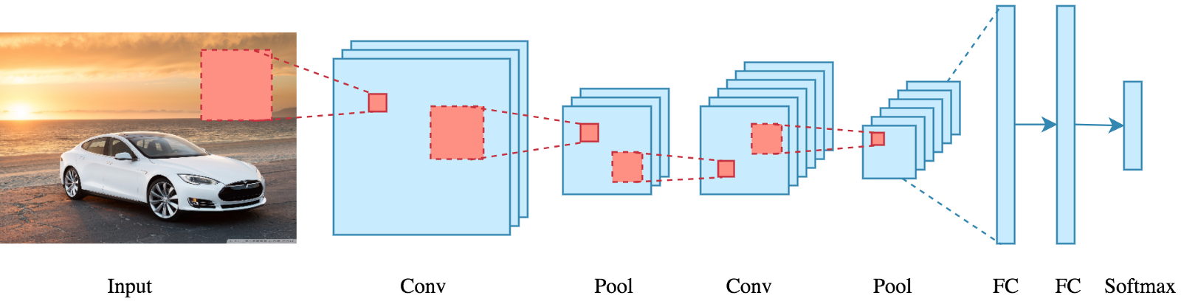
CONVOLUTIONAL NEURAL NETWORKS
CNN has the following five basic components:
Convolution : to detect features in an image
ReLU : to make the image smooth and make boundaries distinct
Pooling : to help fix distored images
Flattening : to turn the image into a suitable representation
Full connection : to process the data in a neural network

Slide 17
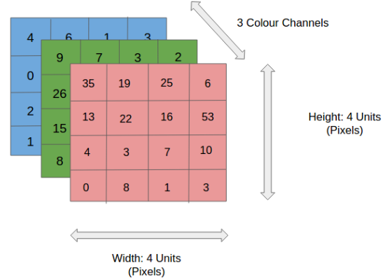
HOW DOES CNN WORK?
An RGB image is nothing but a matrix of pixel values having three planes .
We take a filter/kernel(3×3 matrix) and apply it to the input image
to get the convolved feature.
Convolutional neural networks are composed of multiple layers of artificial neurons. Artificial neurons, a rough imitation of their biological counterparts, are mathematical functions that calculate the weighted sum of multiple inputs and outputs an activation value.
When you input an image in a ConvNet, each layer generates several activation functions that are passed on to the next layer.
The first layer usually extracts basic features such as horizontal or diagonal edges. This output is passed on to the next layer which detects more complex features such as corners or combinational edges. As we move deeper into the network it can identify even more complex features such as objects, faces, etc.
Based on the activation map of the final convolution layer, the classification layer outputs a set of confidence scores (values between 0 and 1) that specify how likely the image is to belong to a “class.”
For instance, if you have a ConvNet that detects cats, dogs, and horses, the output of the final layer is the possibility that the input image contains any of those animals.

Slide 18
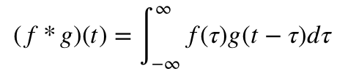
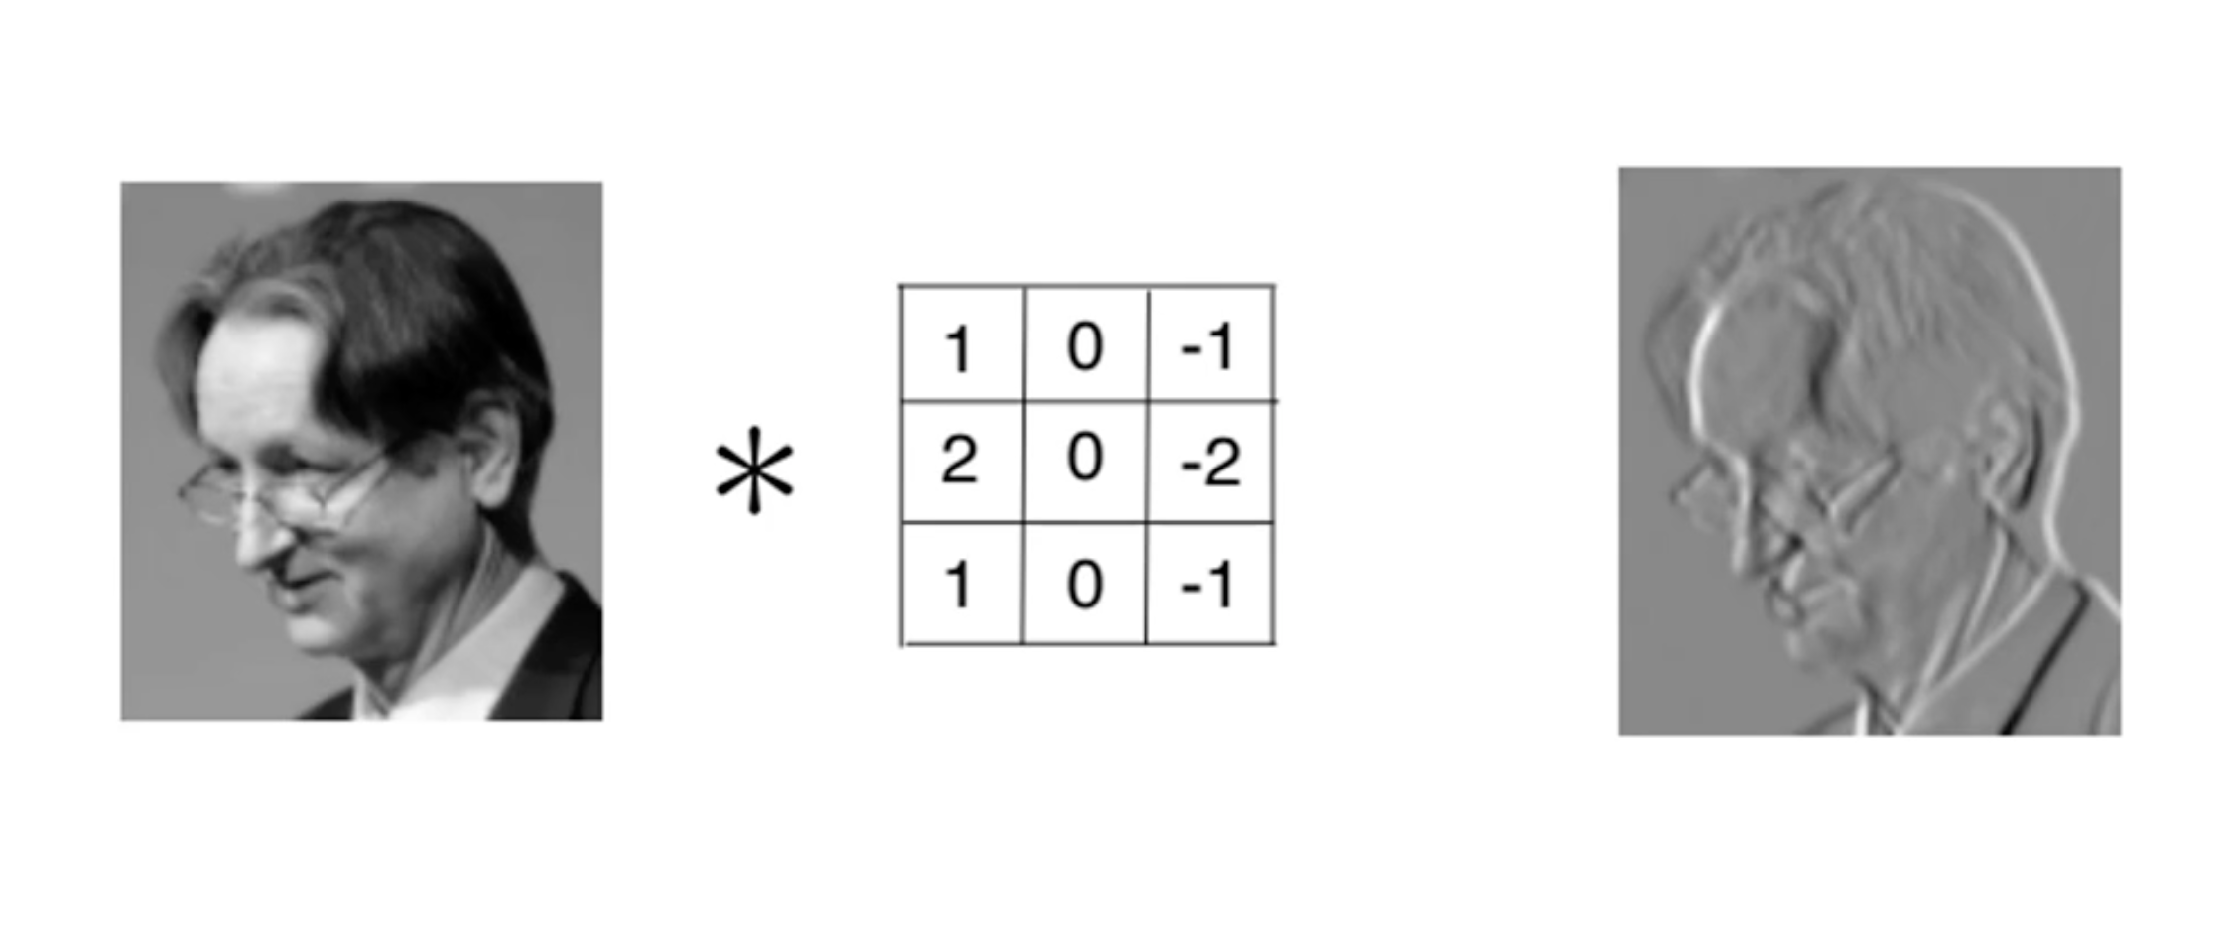
CONVOLUTIONAL
Convolution is the fundamental mathematical operation that is highly useful to detect features of an image. Convolution preserves the relationship between pixels by learning image features using small squares of input data. It is a mathematical operation that takes two inputs:
image matrix
a filter
The motive of this process is to extract all the important features from the image so that our model will only focus on the features and not on the unnecessary information.
So the primary importance of convolution is that it detects features in an image while preserving the spacial features of the image, which if not achieved will serve no purpose.
Certain filters can be used to:
blur an image
detect the edges of an image

Slide 19
CONVOLUTIONAL

Slide 20
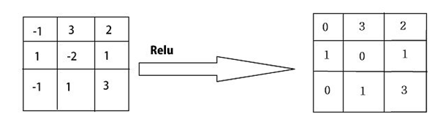
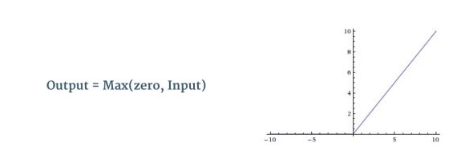
ReLU-Rectified Linear Unit
ReLU is a non-linear operation.ReLU is an element-wise operation (applied per pixel) and replaces all negative pixel values in the feature map by zero.
Thus to decrease the non linearity in the convolution layer, we add the rectifier function say max(x, 0), so that in case if there are negative pixel values, they will be replaced by zeroes.
Intuitively, it is fairly difficult for us to comprehend what the benefit of this step is, but it helps greatly in feature detection because:
it helps in breaking the flow of the gradient in an image
it brings a sharp or drastic change when there is a different feature.

Slide 21
POOLING LAYER
Pooling layer is responsible for reducing the spatial size of the Convolved Feature.
This is to decrease the computational power required to process the data by reducing the dimensions. There are two types of pooling average pooling and max pooling.
Furthermore, it is useful for extracting dominant features which are rotational and positional invariant, thus maintaining the process of effectively training of the model.
In Max Pooling we find the maximum value of a pixel from a portion of the image covered by the kernel.
Max Pooling also performs as a Noise Suppressant. It discards the noisy activations altogether and also performs de-noising along with dimensionality reduction.
Average Pooling returns the average of all the values from the portion of the image covered by the Kernel.
Average Pooling simply performs dimensionality reduction as a noise suppressing mechanism. Hence, we can say that Max Pooling performs a lot better than Average Pooling.

Slide 22
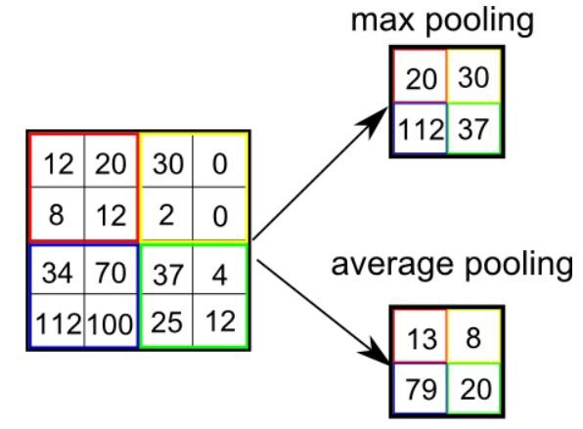
POOLING
The Convolutional Layer and the Pooling Layer, together form the i-th layer of a Convolutional Neural Network.
Depending on the complexities in the images, the number of such layers may be increased for capturing low-levels details even further, but at the cost of more computational power.
After going through the above process, we have successfully enabled the model to understand the features.
Moving on, we are going to flatten the final output and feed it to a regular Neural Network for classification purposes.

Slide 23
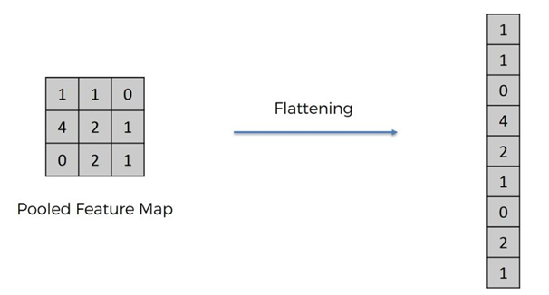
FLATTENING
In the flattening procedure, we basically take the elements in a pooled feature map and put them in a vector form. This becomes the input layer for the upcoming ANN.
Flattening is the process of converting al the resultant 2-dimensional arrays into a single long continuous linear vector.
Notes:
Good reference:
https://medium.com/machine-learning-researcher/convlutional-neural-network-cnn-2fc4faa7bb63

Slide 24
Strides
Stride is the number of pixels shifts over the input matrix. When the stride is 1 then we move the filters to 1 pixel at a time. When the stride is 2 then we move the filters to 2 pixels at a time and so on.
Padding
We can observe that the size of output is smaller that input. To maintain the dimension of output as in input , we use padding. Padding is a process of adding zeros to the input matrix symmetrically. In the following example,the extra grey blocks denote the padding.
Sometimes filter does not perfectly fit the input image. We have two options:
Pad the picture with zeros (zero-padding) so that it fits
Drop the part of the image where the filter did not fit. This is called valid padding which keeps only valid part of the image.

Slide 25
Fully Connected Layer(FC Layer)
Once the image is convolved, max pooled and flattened, the result is a vector. This vector acts as the input layer for an ANN which then works normally to detect the image.
The Fully Connected layer is a traditional Multi-Layer Perceptron that uses a softmax activation function in the output layer.
The term “Fully Connected” implies that every neuron in the previous layer is connected to every neuron on the next layer.
It assigns random weights to each synapse, the input layer is weight adjusted and put into an activation function. The output of this is then compared to the true values and the error generated is back-propagated, i.e. the weights are re-adjusted and all the processes repeated. This is done until the error or cost function is minimised.
The output from the convolutional and pooling layers represent high-level features of the input image. The purpose of the Fully Connected layer is to use these features for classifying the input image into various classes based on the training dataset.
Apart from classification, adding a fully-connected layer is also a cheap way of learning non-linear combinations of these features. Most of the features from convolutional and pooling layers may be good for the classification task, but combinations of those features might be even better. The sum of output probabilities from the Fully Connected Layer is 1. This is ensured by using the Softmax as the activation function in the output layer of the Fully Connected Layer.
The Softmax function takes a vector of arbitrary real-valued scores and squashes it to a vector of values between zero and one that sums to one.

Slide 26
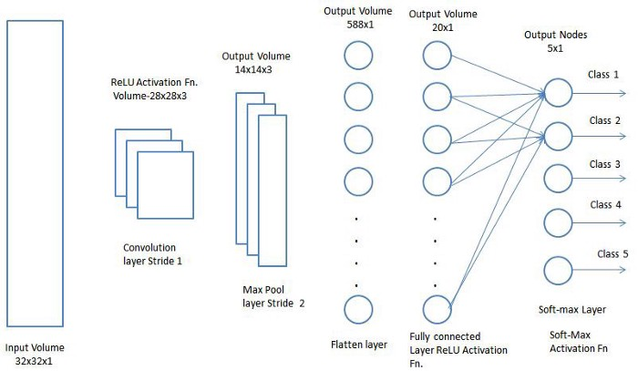
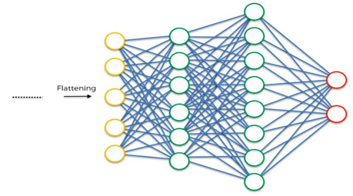
FC LAYER
Notes:
https://iq.opengenus.org/convolutional-neural-networks/

Slide 27
APPLICATIONS OF CNN
Image Classification
OCR and image recognition
Detecting objects in self-driving cars
Social media face recognition
Image analysis in medicine
Decoding Facial Recognition
Analysing Documents
Understanding Climate
Advertising
introduction of programmatic buying and data-driven personalized advertising.
Various architectures of CNNs
LeNet
AlexNet
VGGNet
GoogLeNet
ResNet
ZFNet

Slide 28

RNN
Recurrent neural networks (RNN) are a class of neural networks that are helpful in modeling sequence data.
Derived from feedforward networks, RNNs exhibit similar behavior to how human brains function.
Because of their internal memory, RNN’s can remember important things about the input they received, which allows them to be very precise in predicting what’s coming next.
Recurrent neural networks produce predictive results in sequential data that other algorithms can’t.
Algorithm for sequential data and are used by Apple's Siri and and Google's voice search.
Vanishing Gradient

Slide 29
Long Short-Term Memory (LSTM)
Long Short-Term Memory (LSTM) networks are an extension of RNN that extend the memory.
LSTM are used as the building blocks for the layers of a RNN.
LSTMs assign data “weights” which helps RNNs to either let new information in, forget information or give it importance enough to impact the output.
LSTMs enable RNNs to remember inputs over a long period of time.
This is because LSTMs contain information in a memory, much like the memory of a computer. The LSTM can read, write and delete information from its memory.
This memory can be seen as a gated cell, with gated meaning the cell decides whether or not to store or delete information based on the importance it assigns to the information.
The assigning of importance happens through weights, which are also learned by the algorithm.
It learns over time what information is important and what is not.
In an LSTM you have three gates: input, forget and output gate.

Slide 30
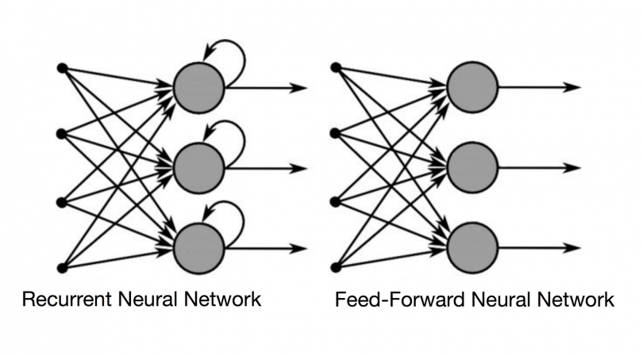
How Recurrent Neural Networks Work ?
Sequential data is basically just ordered data in which related things follow each other.
-Examples are financial data or the DNA sequence.
In a feed-forward neural network, the information only moves in one direction — from the input layer, through the hidden layers, to the output layer.
Feed-forward neural networks have no memory of the input they receive and are bad at predicting what’s coming next.
In a RNN the information cycles through a loop. When it makes a decision, it considers the current input and also what it has learned from the inputs it received previously.
Recurrent Neural Networks Add The Immediate Past To The Present.
Therefore, a RNN has two inputs: the present and the recent past.
RNNs apply weights to the current and also to the previous input.
Furthermore, a recurrent neural network will also tweak the weights
for both through gradient descent and backpropagation through time (BPTT).

Slide 31
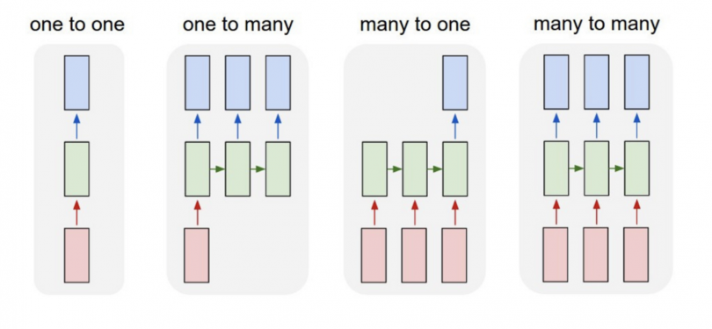
TYPES OF RNN

Slide 32
RNN
THIS IS A GIF FILE PLEASE VIEW IN SLIDE SHOW MODE
Notes:
https://builtin.com/data-science/recurrent-neural-networks-and-lstm

Slide 33
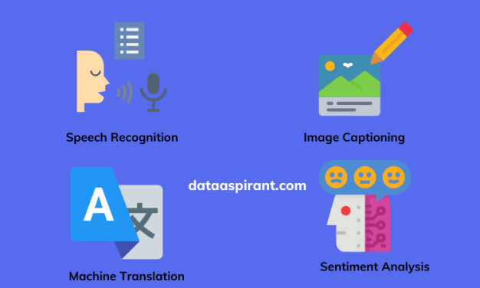
APPLICATIONS OF RNN
Prediction problems
Machine Translation
Speech Recognition
Language Modelling and Generating Text
Video Tagging
Generating Image Descriptions
Text Summarization
Call Center Analysis
Face detection,
OCR Applications as Image Recognition

Slide 34
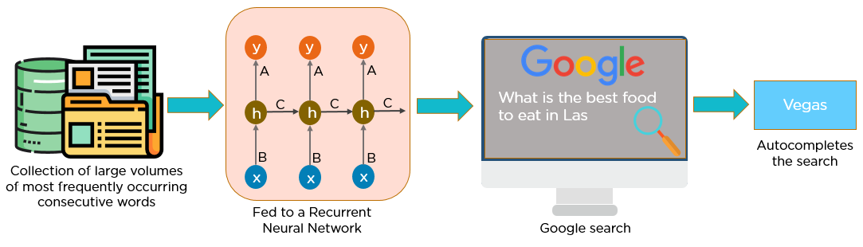
APPLICATIONS OF RNN

Slide 35
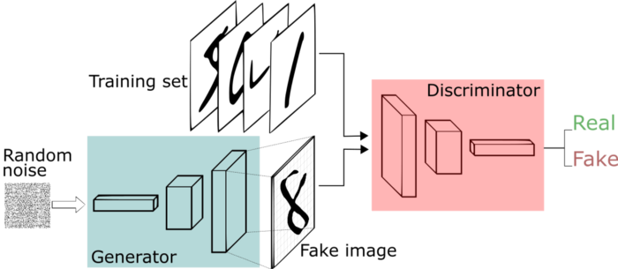
GAN-Generative Adversarial Networks

Slide 36
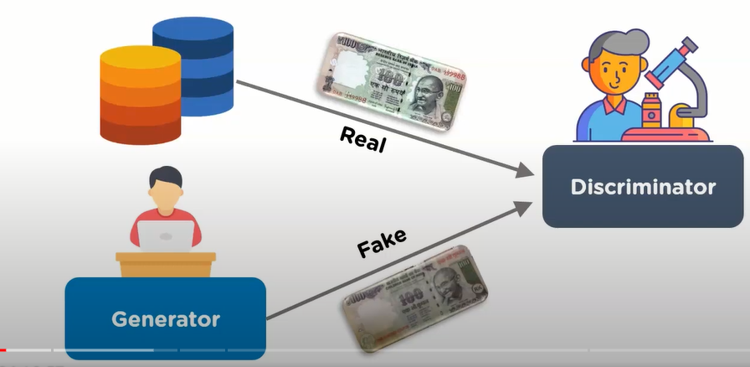
GAN
Generative adversarial networks (GANs) consists of two models that compete with each other to analyze ,capture and copy the variations within a dataset.
They are used widely in image generation, video generation and voice generation.

Slide 37
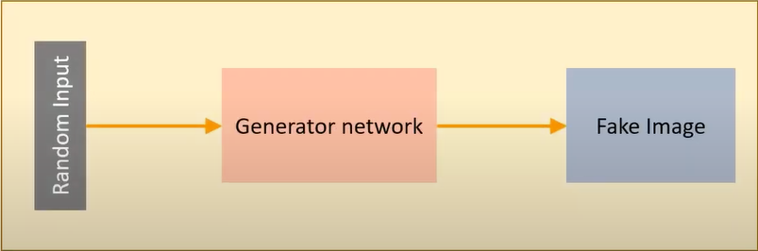
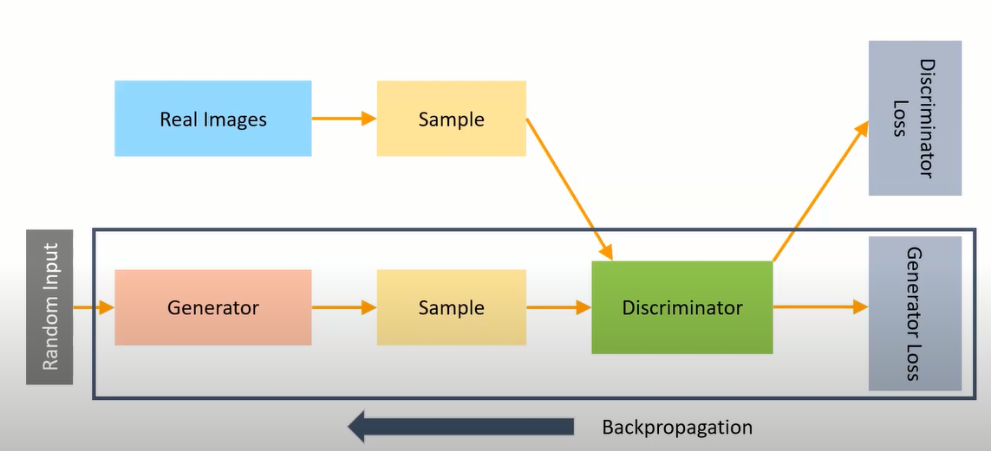
GENERATOR
Generator-The generator in GAN learns to create fake data by incorporating feedback from the discriminator.
The generator learns to generate plausible data. The generated instances become negative training examples for the discriminator.
Generator Training

Slide 38
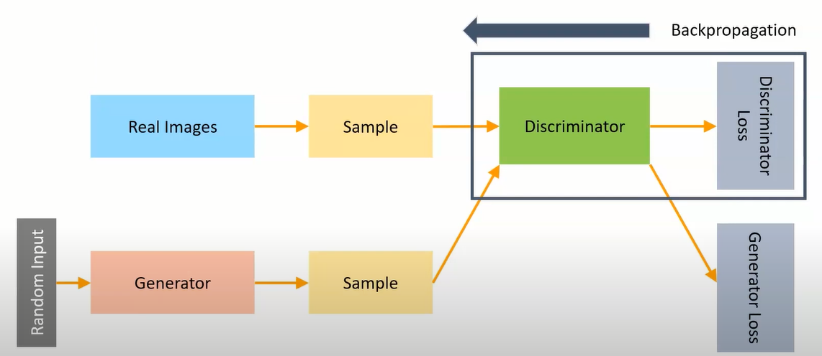
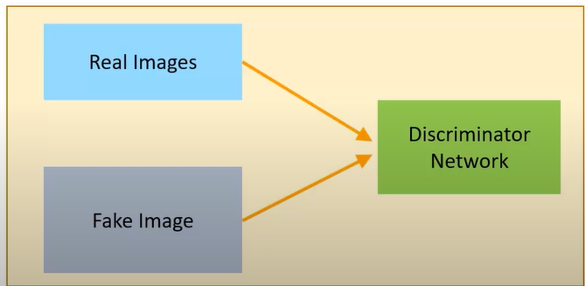
DISCRIMINATOR
The discriminator in GAN is a classifier that identifies real data from the fake data created by the generator.
The discriminator penalizes the generator for producing implausible results.
Discriminator Training

Slide 39
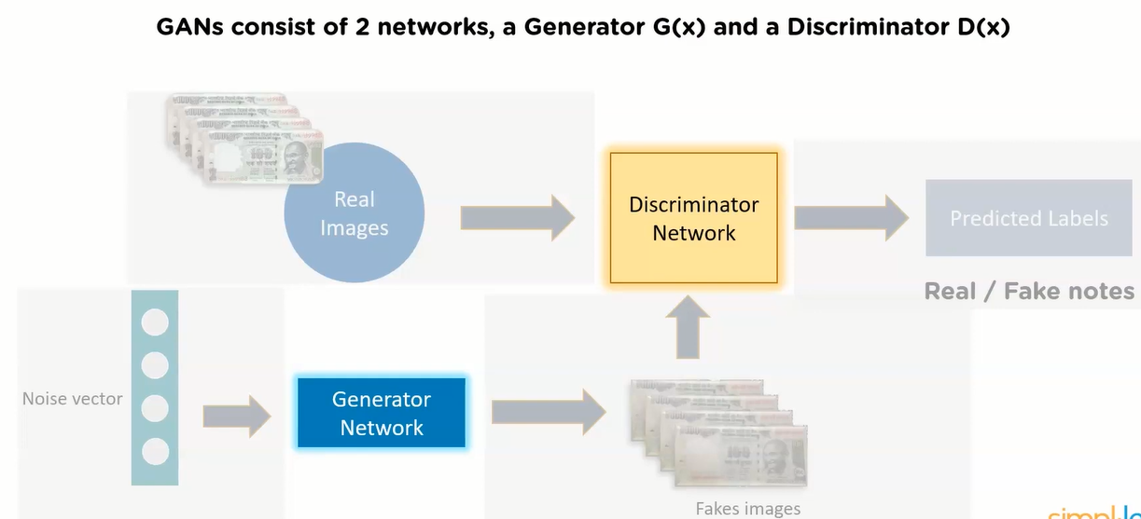
HOW GAN’s WORK?
The generator learn the distribution of data and is trained to increase the probability of the discriminator network to make mistakes.
The discriminator estimates the probability that the sample it got is from the training data and not from the Generator.
One neural network, called the generator, generates new data instances, while the other, the discriminator, evaluates them for authenticity; i.e. the discriminator decides whether each instance of data that it reviews belongs to the actual training dataset or not.

Slide 40
Application of GAN
Generating Cartoon Characters-Using DCGAN s ,you can create faces of anime and Pokemon characters.
Generating Human Faces-can be trained on the Images of human to generate realistic faces.
Text to image translation –can build realistic images from textual; descriptions of simple objects like birds.
3-D generation –can generate 3 d models from 2 d pictues of objects from multiple perspectives.

Slide 41
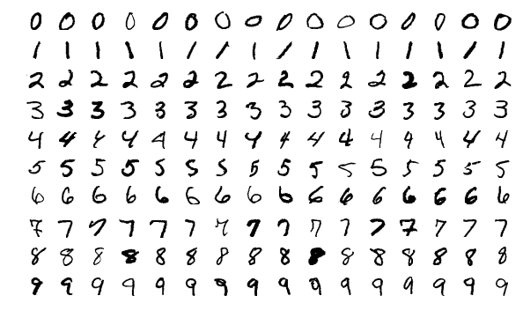
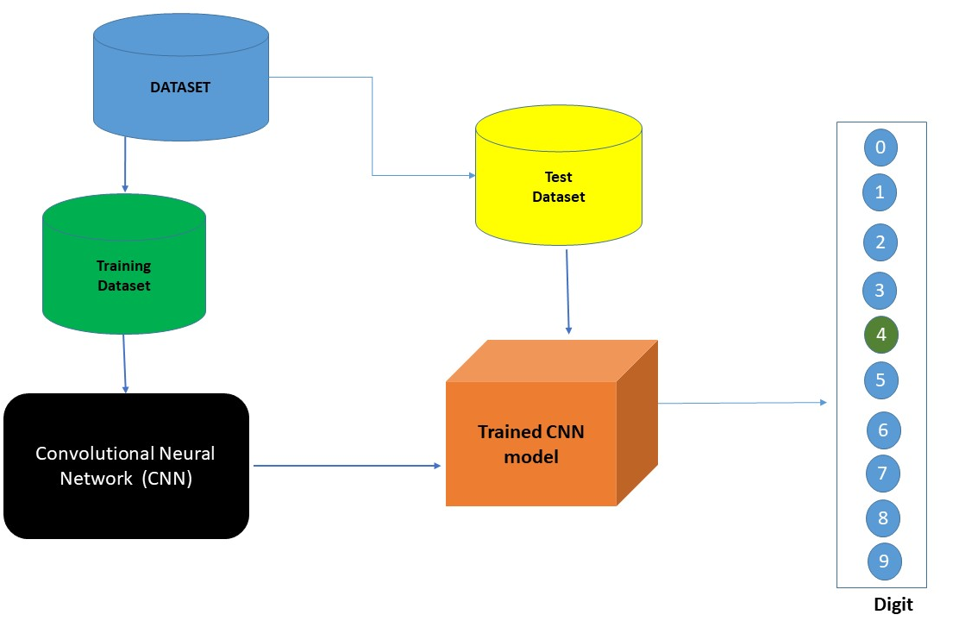
Classification of Handwritten Digits Using CNN
I have attached the code in github repository and executed in google colab.

Slide 42
REFERENCES
CNN
https://medium.com/machine-learning-researcher/convlutional-neural-network-cnn-2fc4faa7bb63
https://towardsdatascience.com/a-comprehensive-guide-to-convolutional-neural-networks-the-eli5-way-3bd2b1164a53
https://www.ibm.com/cloud/learn/convolutional-neural-networks
https://iq.opengenus.org/convolutional-neural-networks/
https://victorzhou.com/blog/intro-to-cnns-part-1/

Slide 43
REFERENCES
RNN
https://builtin.com/data-science/recurrent-neural-networks-and-lstm
https://towardsdatascience.com/illustrated-guide-to-recurrent-neural-networks-79e5eb8049c9
GAN
https://developers.google.com/machine-learning/gan/gan_structure
https://www.youtube.com/watch?v=MZmNxvLDdV0

Slide 44
THANK YOU
Tejaal M ENG19CS0334

